Slide 1
AD CODING COMPETITION 2012
28 June 2012
AIDAN & PAVAN

Slide 2


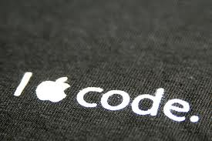
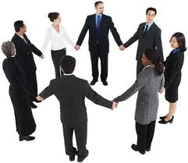
It’s all about….

Slide 3


Getting Started..
https://github.com/ptpavankumar/Competition
https://www.yammer.com/myob.com/groups/adcodingcompetition

Slide 4
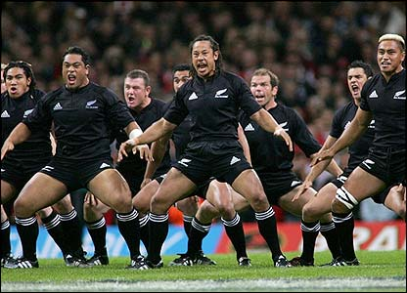
The challenge

Slide 5




The tools…

Slide 6
Key Note !

Slide 7
FAQ
How long will the competition run for?
What’s the prize?
Who are the judges?
Who can enter?
So how much will it costs me to build my app?
When will I get time to build my app?

Slide 8
FAQ
What the judging criteria?
Collaboration
Innovation
Presentation
working solution

